Slide 1
COVID-19 Statistics
15-04-2020

Slide 2
Latest Statistics
(updated 15-04-2020)
Total confirmed cases worldwide: 2,055,333
79,863 new cases (4% increase)
Total fatal cases worldwide: 134,163
8,193 new fatalities (6% increase)
Israel recorded 12,501 cases in total
increased by 455 cases (3% increase)
19.0# in confirmed cases, 38.0# in mortality
20.0# in cases per capita, 36.0# in mortality rate

Slide 3
Latest Statistics
(updated 15-04-2020)
Worldwide mortality rate: 6.5% (+0.2%)
Israel mortality rate: 1.0% (+0.0%)
US has most cases in total (636,350)
US has most fatal cases in total (US)
US recorded the most new cases (28,680)
US recorded the most new fatal cases (2,494)

Slide 4
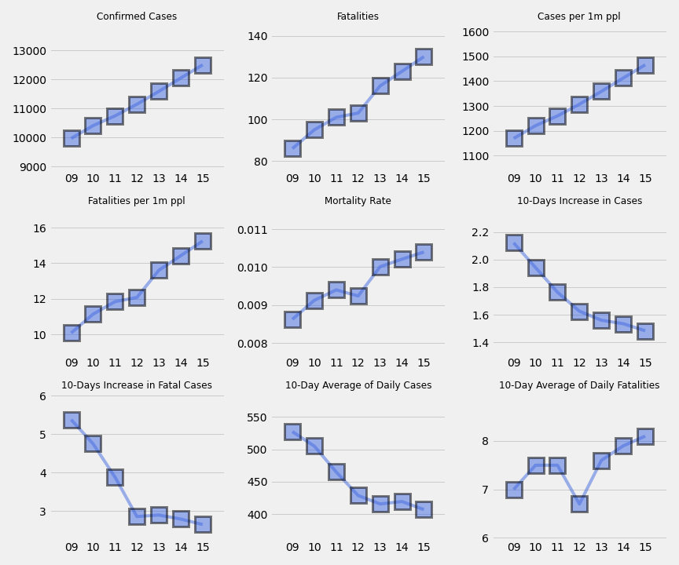
Main indicators in Israel
Progression in the last week

Slide 5
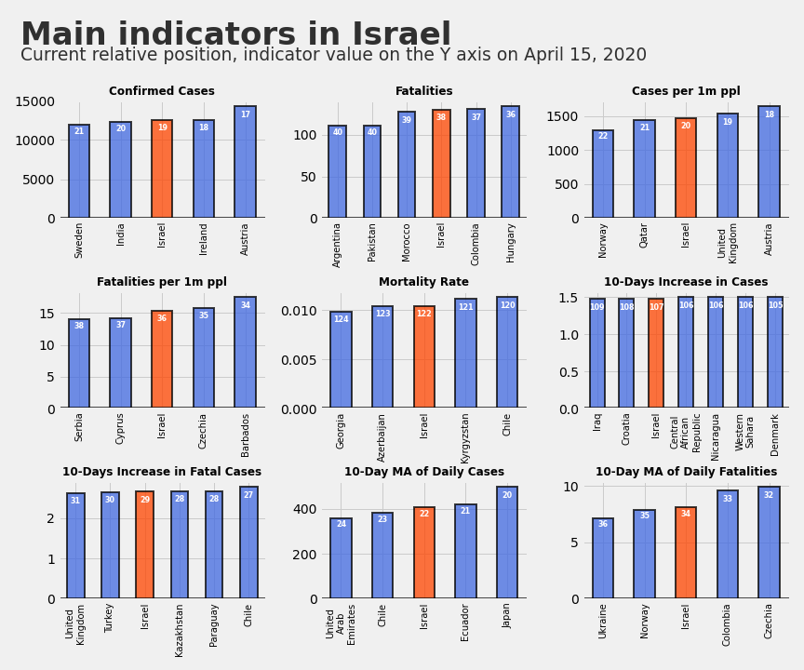
Israel on Key Metrics

Slide 6
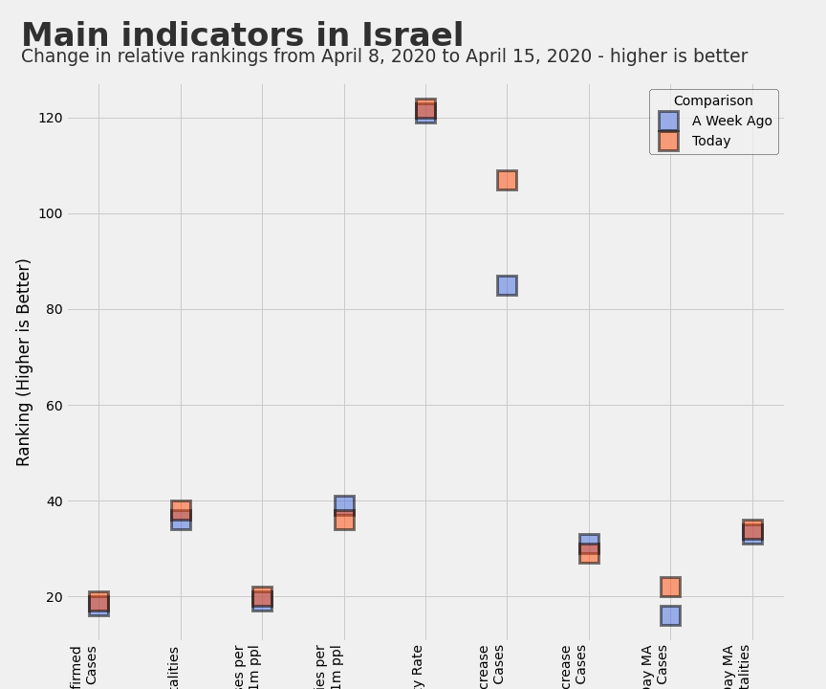
Changes in Israel's Rankings from Last Week

Slide 7
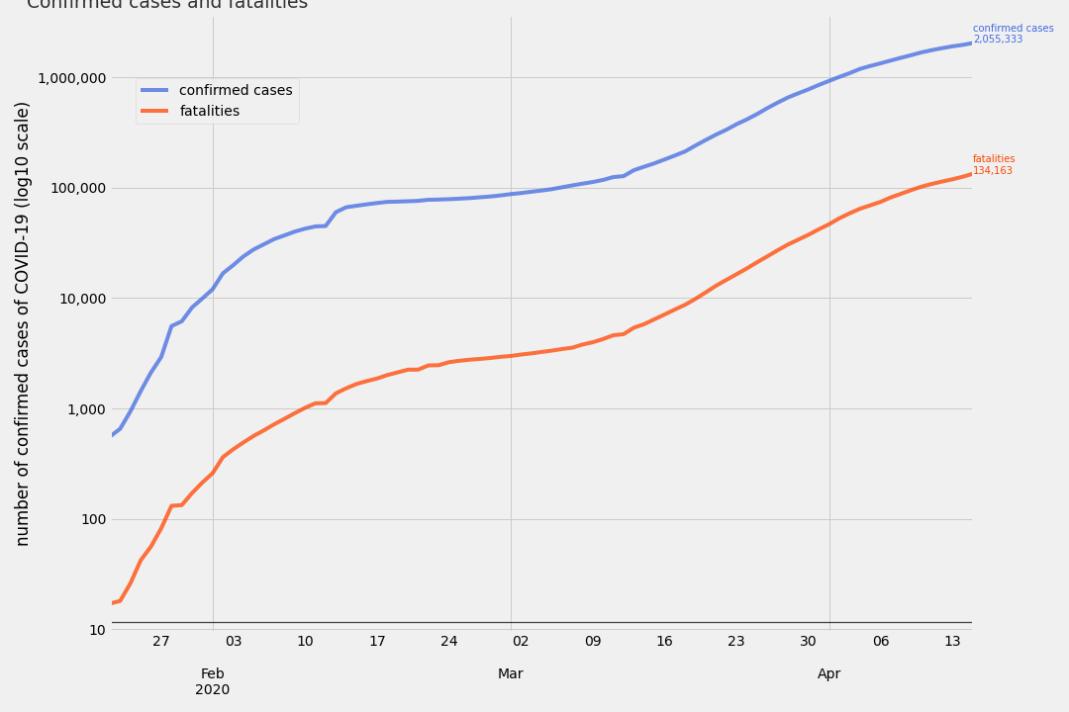
COVID-19 confirmed cases vs COVID-19 fatalities, logarithmic scale

Slide 8
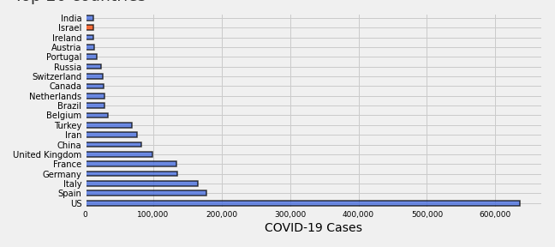
Top 20 Countries by COVID-19 Cases

Slide 9
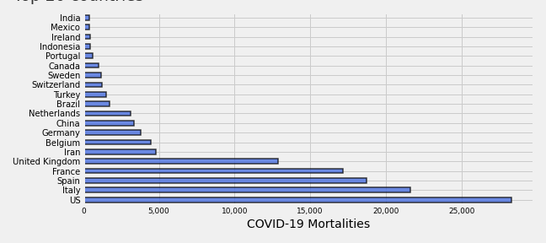
Top 20 Countries by Fatal COVID-19 Cases

Slide 10
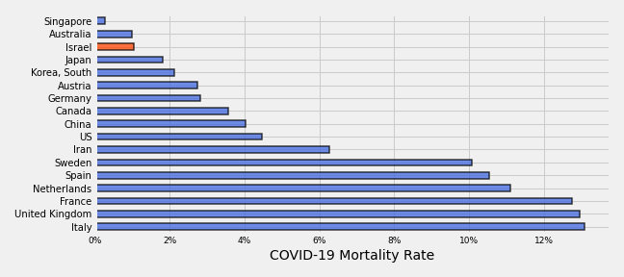
Countries by COVID-19 Mortality Rates

Slide 11
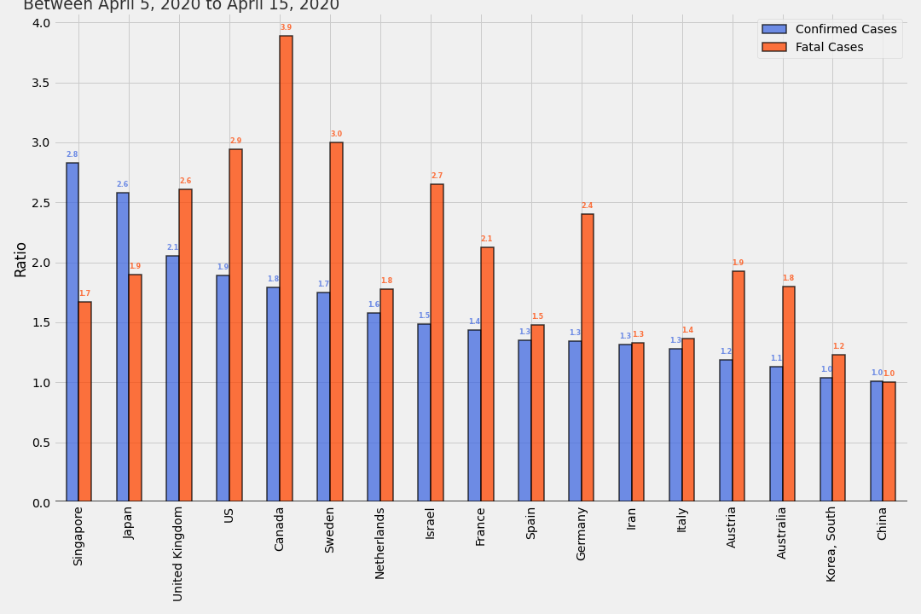
Ratio Between Today and 10 Days Ago

Slide 12
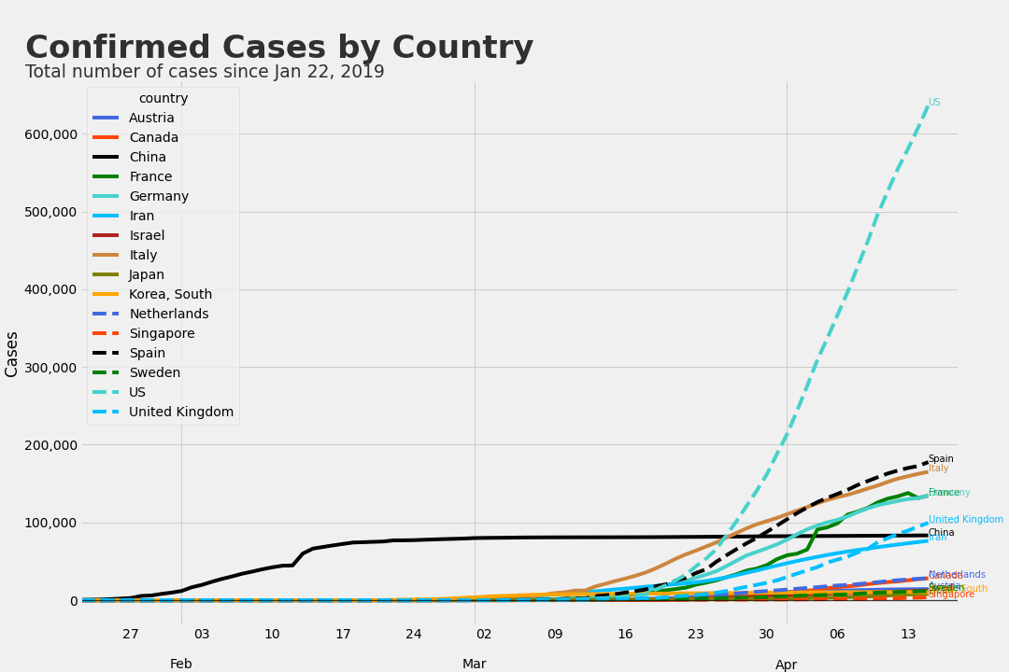
Confirmed Cases by Country

Slide 13
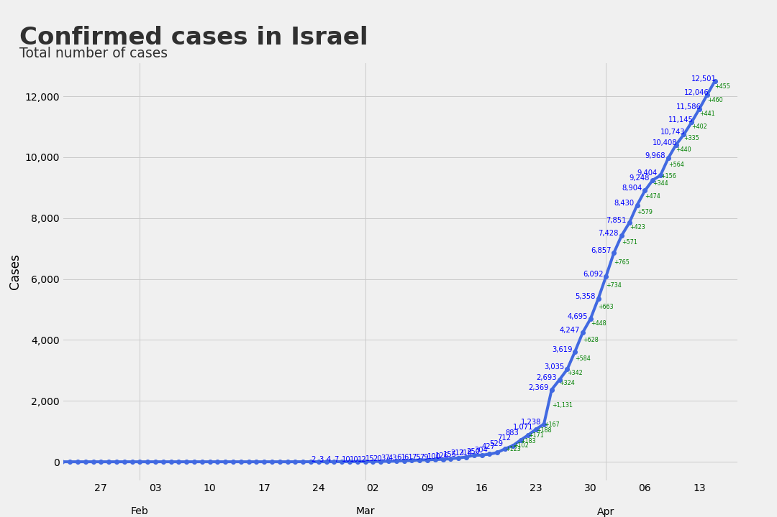
Confirmed Cases in Israel

Slide 14
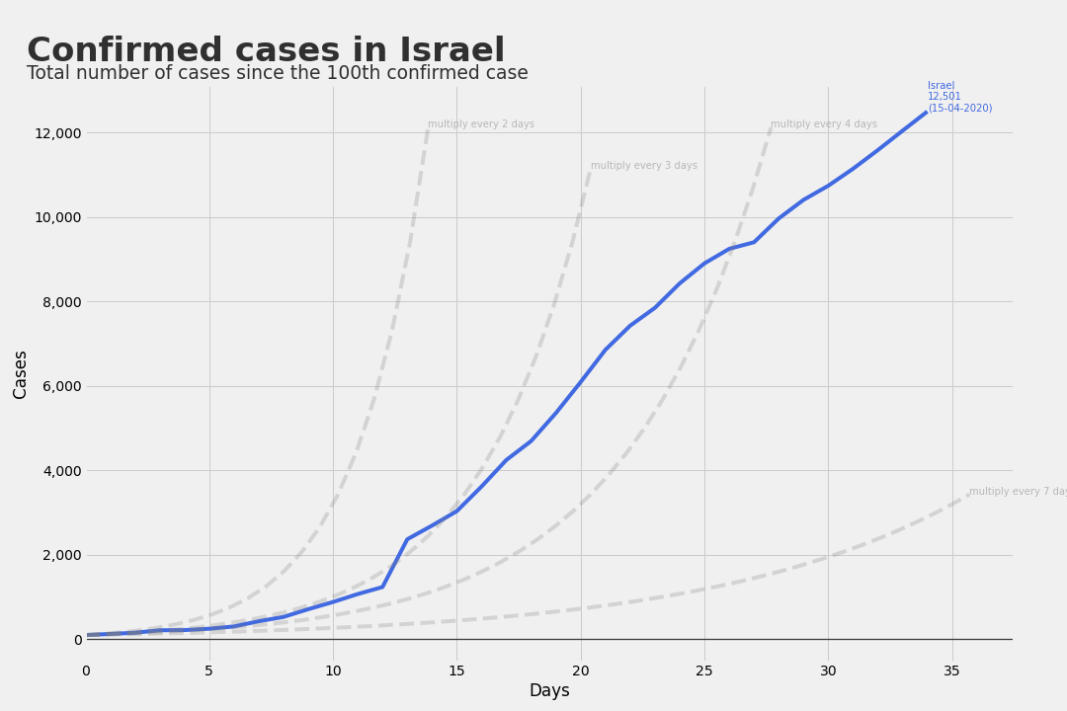
Confirmed Cases in Israel
Since the 100th Case

Slide 15
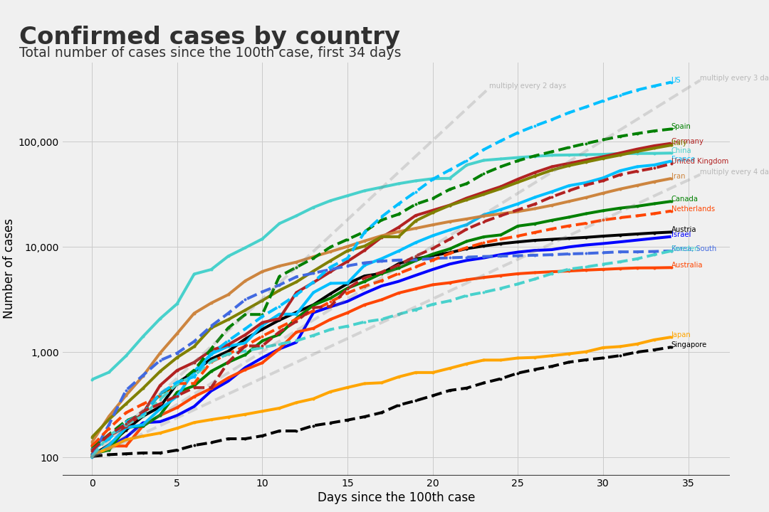
Confirmed Cases
Since the 100th Case, First 34 Days

Slide 16
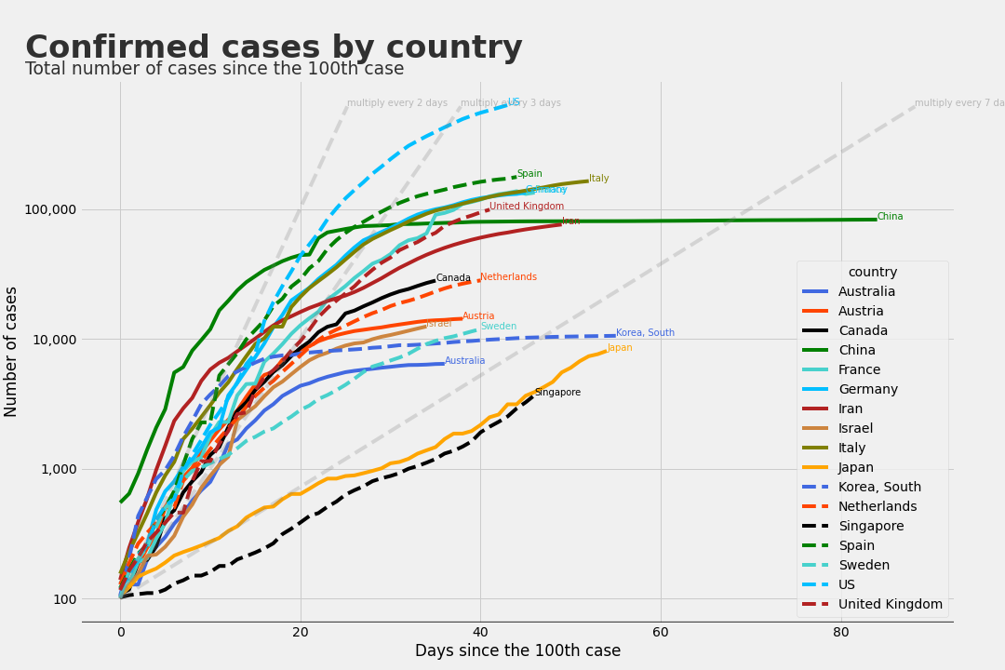
Confirmed Cases
Since the 100th Case

Slide 17
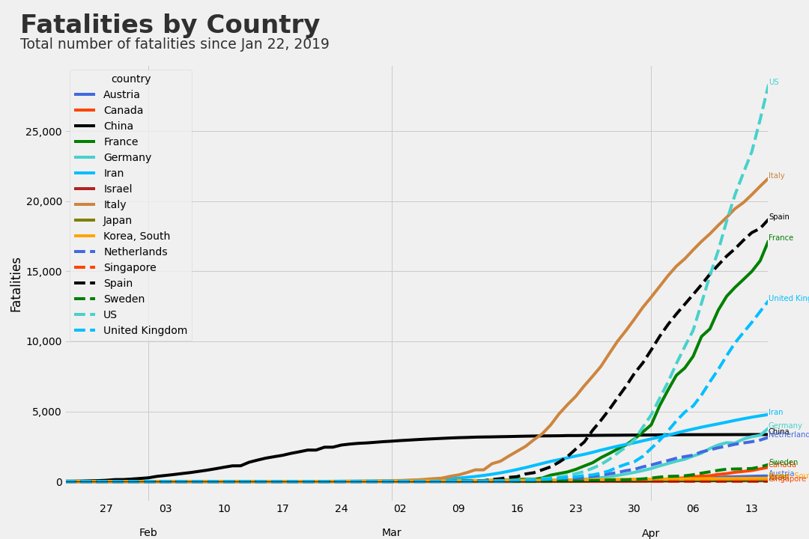
Fatal Cases by Country

Slide 18
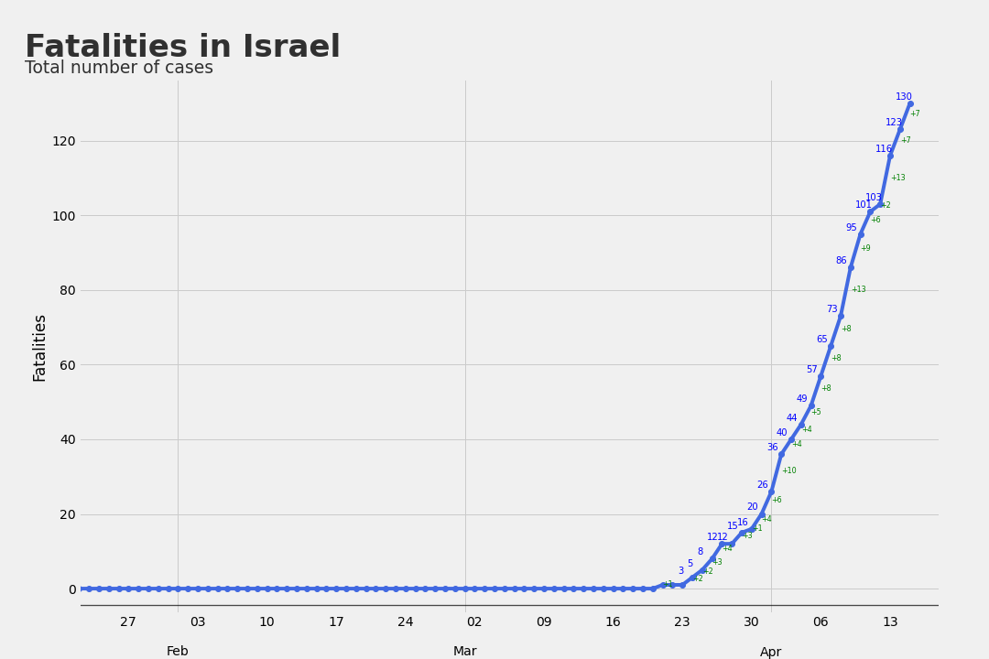
Fatal Cases in Israel

Slide 19
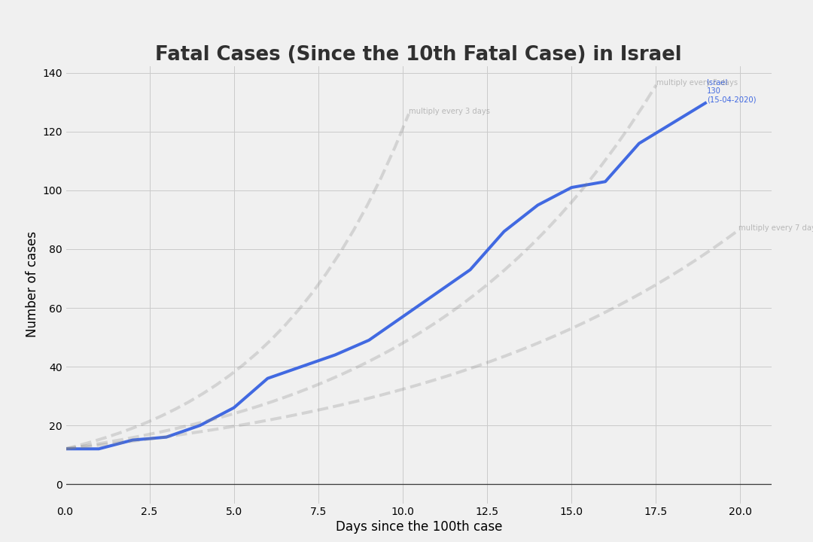
Fatal Cases in Israel
Since the 100th Case

Slide 20
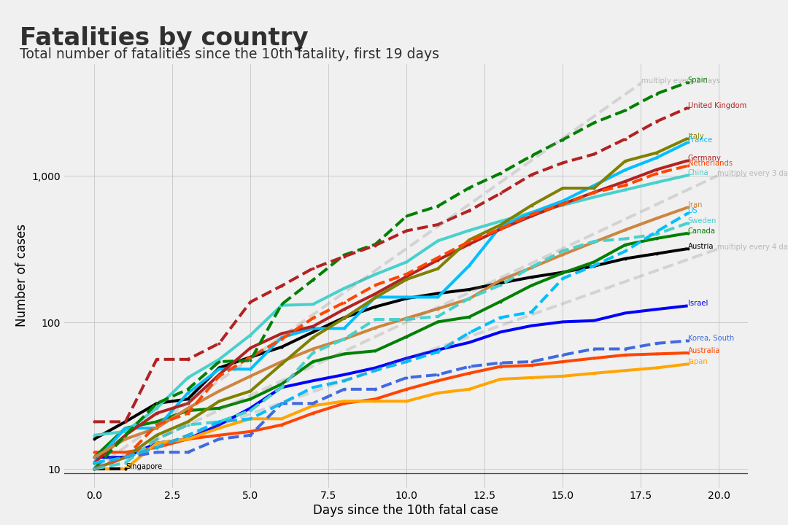
Fatal Cases
Since the 10th Case, First 19 Days

Slide 21
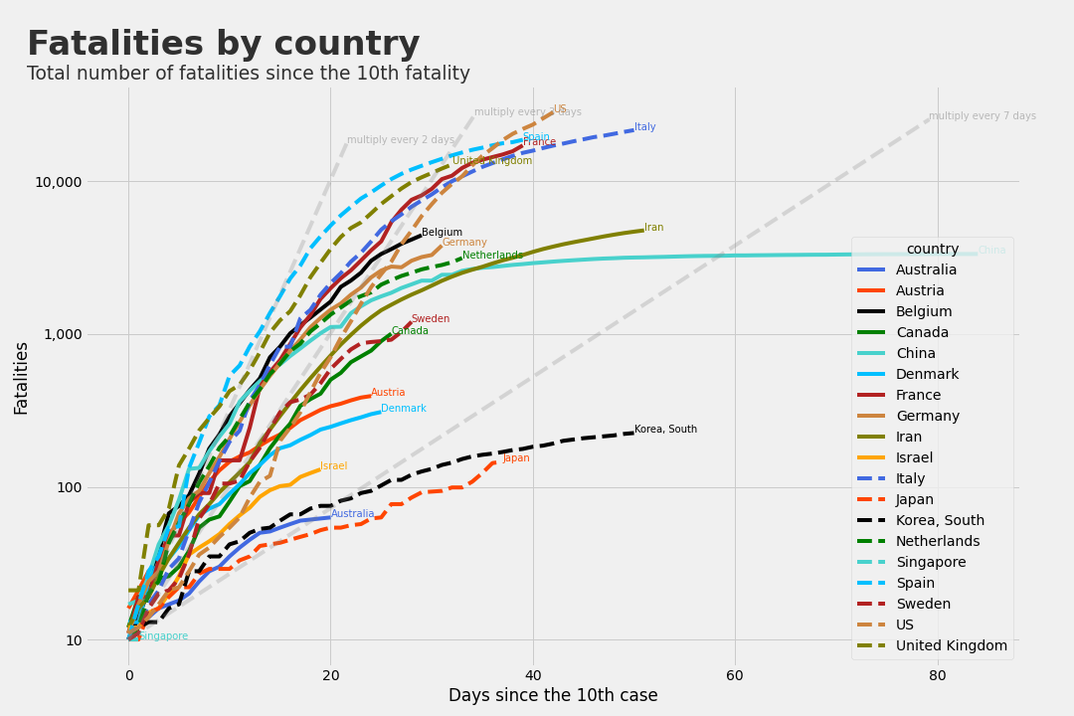
Fatal Cases
Since the 10th Case

Slide 22
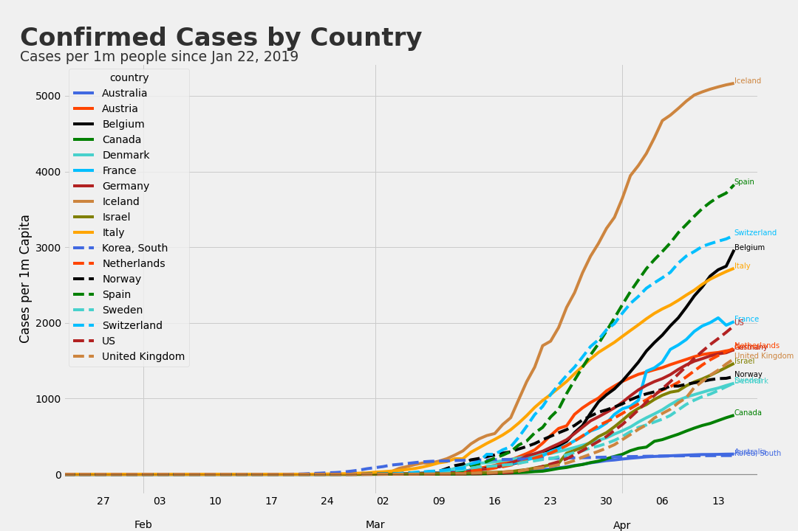
Confirmed Cases by Country
per 1m People

Slide 23
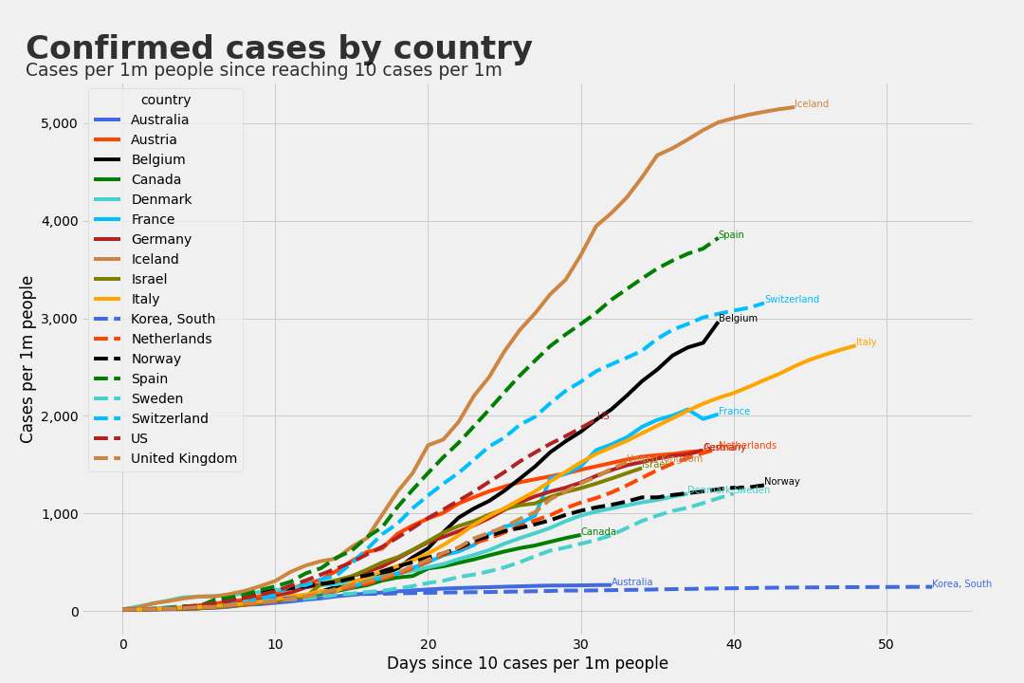
Cases per 1m People
Since Reaching 10 Cases per 1m

Slide 24
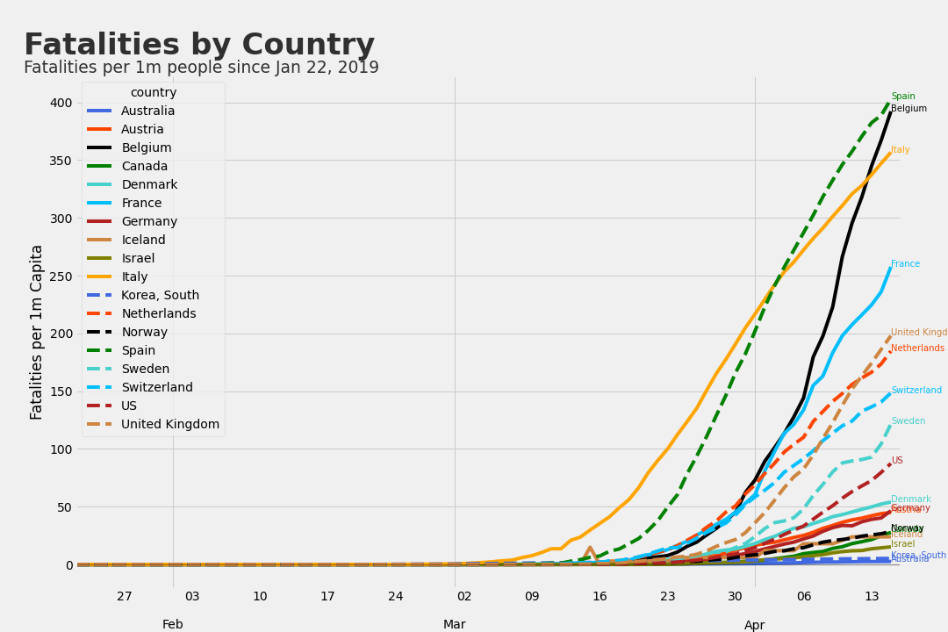
Fatal Cases by Country
per 1m People

Slide 25
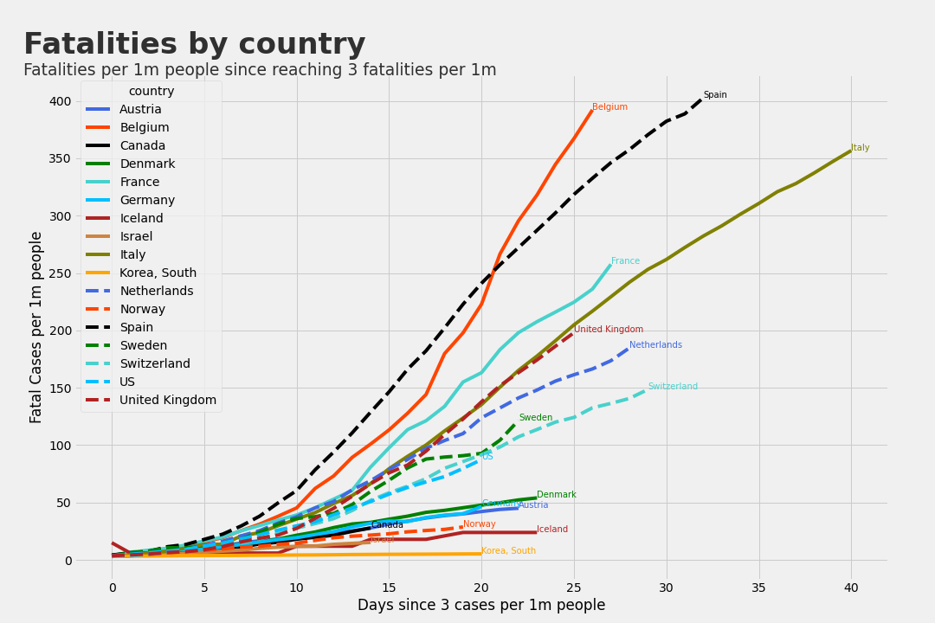
Fatal Cases per 1m People
Since Reaching 3 Cases per 1m

Slide 26
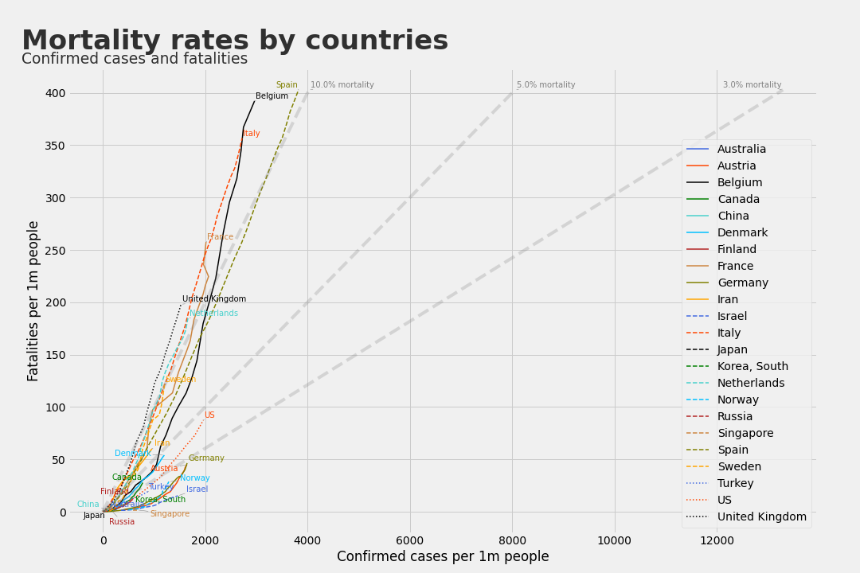
Cases and Mortality per 1m People

Slide 27
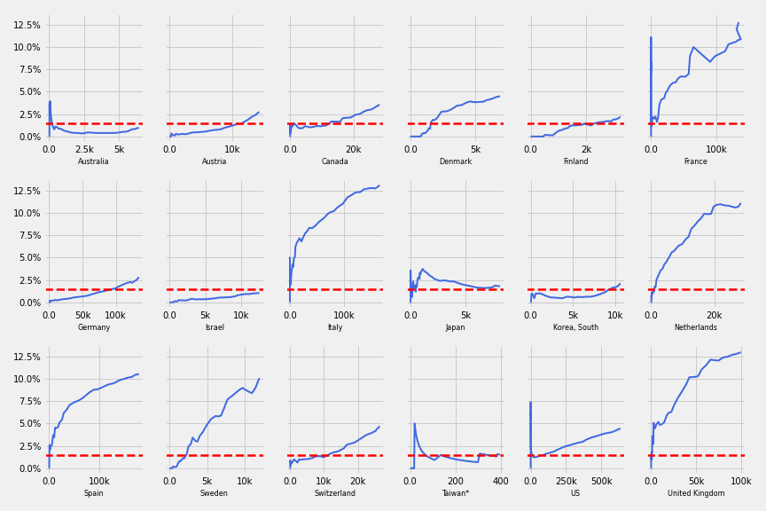
Incrasing number of cases vs mortality rate

Slide 28
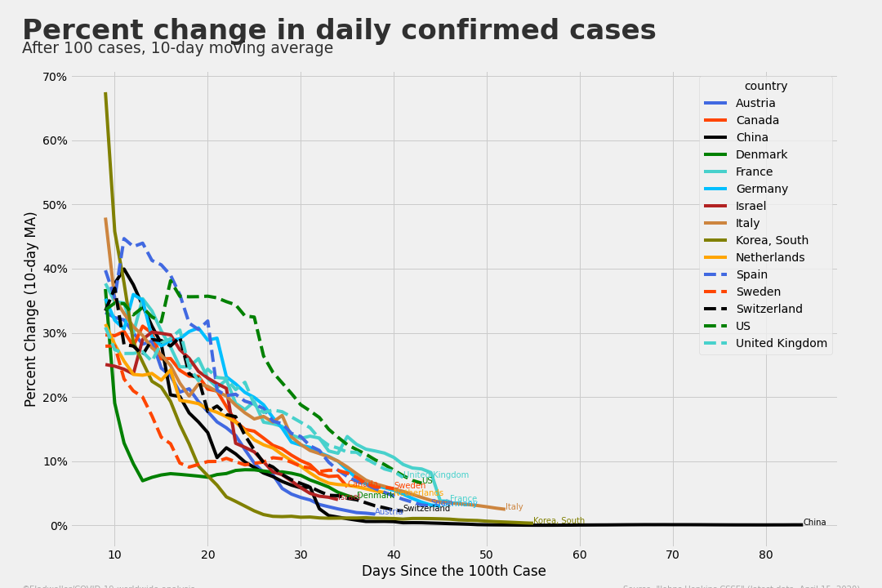
Percent Change in Cases
Since the 100th case, 10-days moving average

Slide 29
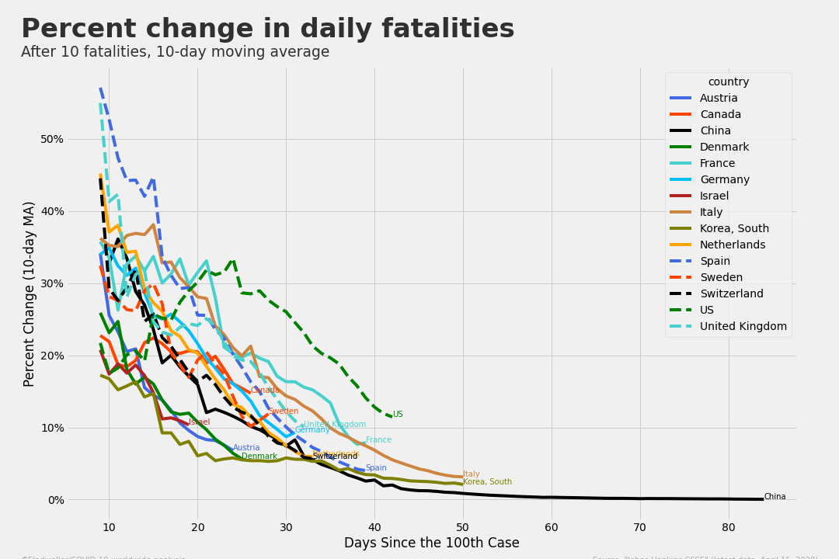
Percent Change in Fatal Cases
After 10 Fatal Cases, 10-days Moving Average

Slide 30
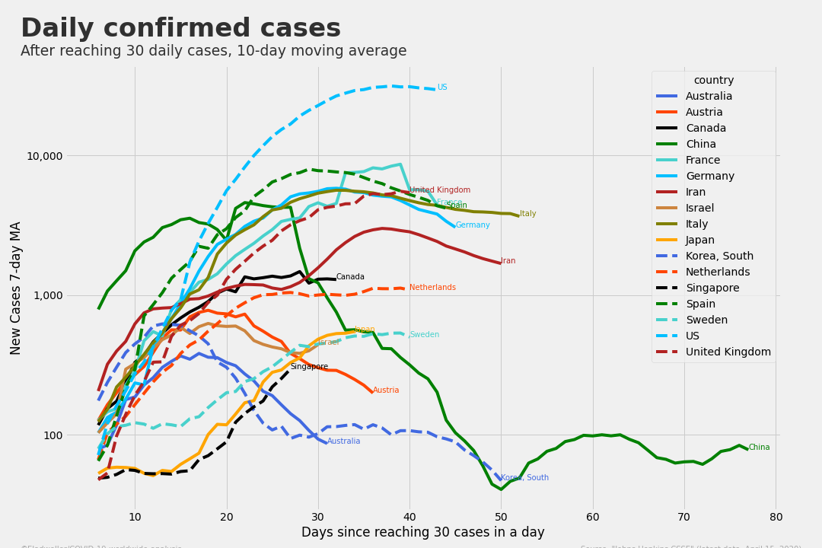
New Confirmed Cases per Day
Since Reaching 30, 7-day Moving Average

Slide 31
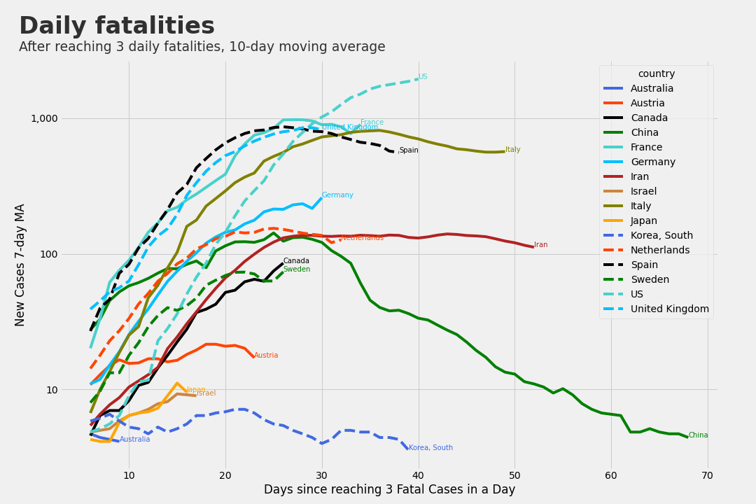
New Fatal Cases per Day
Since Reaching 3, 7-day Moving Average

Slide 32
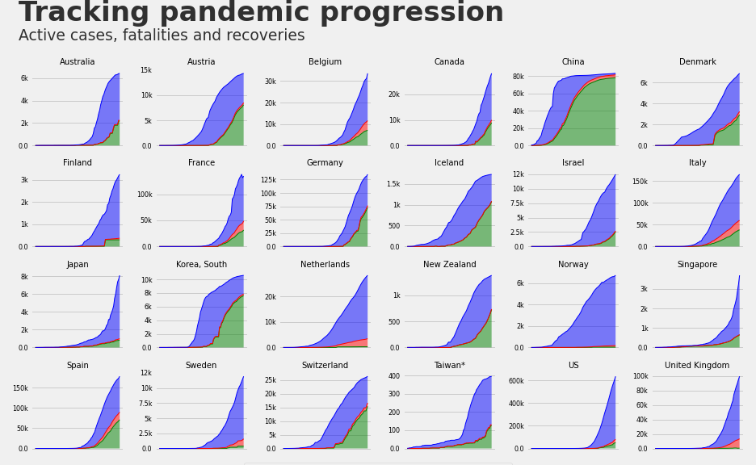
Pandemic Progression

